Slide 1
SELF-SUPERVISED DEEP LEARNING RECONSTRUCTION for HIGHLY ACCELERATED DIFFUSON IMAGING
Ismail Arda Vurankaya¹, Yohan Jun^{2,3}, Jaejin Cho^{2,3}, Berkin Bilgic^{2,3,4}
Bogazici University, Istanbul, Turkey
Athinoula A. Martinos Center for Biomedical Imaging, Charlestown, MA, United States
Department of Radiology, Harvard Medical School, Boston, MA, United States
Harvard/MIT Health Sciences and Technology, Cambridge, MA, United States

Slide 2
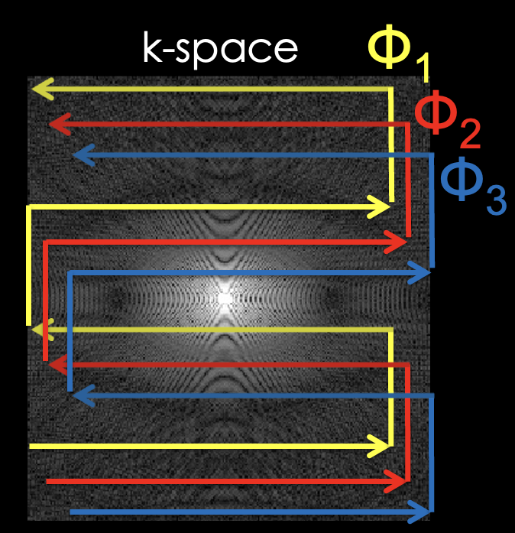
Echo Planar Imaging (EPI)
EPI efficiently covers the entire k-space plane in a single excitation, but suffers from distortion and blurring.
Multishot EPI mitigates this problem, but combining the shots is hard due to phase variations.

Slide 3
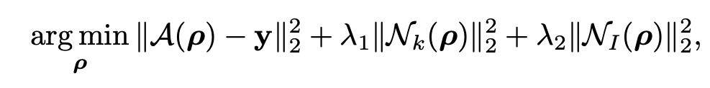
Aim: Applying the previously introduced Zero-Shot Self Supervised Learning (ZS-SSL) framework to multishot diffusion MRI reconstruction. Problem Formulation
The multishot reconstruction problem can be formulated as above. Unlike standard ZS-SSL, which only uses image space regularization, we also use a k-space regularizer, which better exploits the relations between shots.
This problem can be solved by algorithm unrolling. We employ Conjugate-Gradient (CG) SENSE algorithm for the DC step, and regularization sub-problem is implicitly solved by a neural network.

Slide 4
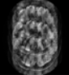
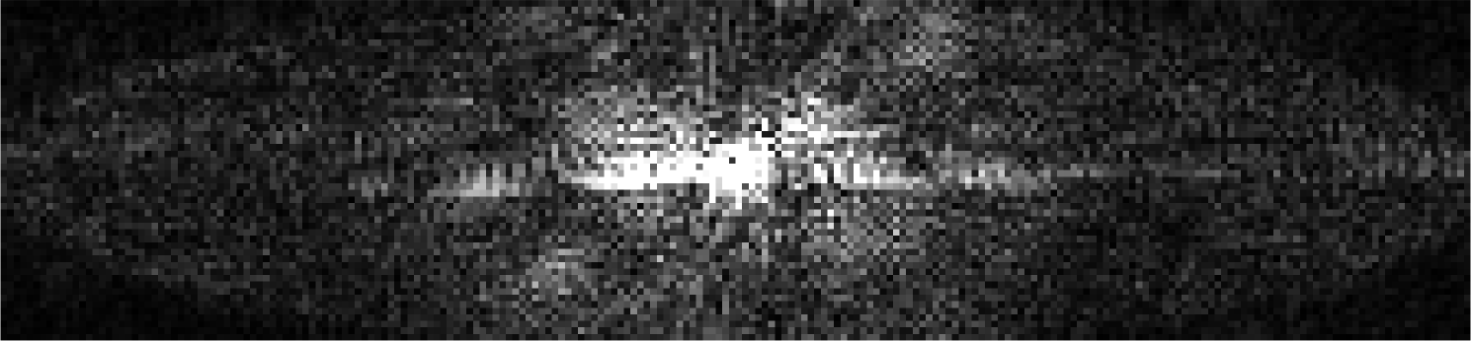






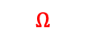


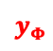




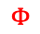



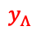
a. Training
$$y_{Θ}$$
Unrolled Network
$$Ω$$
$$A^{H}$$
Image Denoiser
$$y$$
DC Layer
$$k_{y}$$
$$z$$
K-space Denoiser
$$k_{z}$$
$$Θ$$
Sampled points
Unsampled points
$$y_{Φ}$$
Updating Parameters $θ$
$$y$$
$$Φ$$
Training Loss
$$y_{Λ}$$
$$k_{y}$$
Coil
$$Λ$$
Validation
$$k_{z}$$
Undersampled multi-shot k-space
b. Inference
Unrolled Network
$$A^{H}$$
Image Denoiser
$$y$$
DC Layer
$$y$$
$$z$$
K-space Denoiser
$$z$$
Reconstructed Images

Slide 5
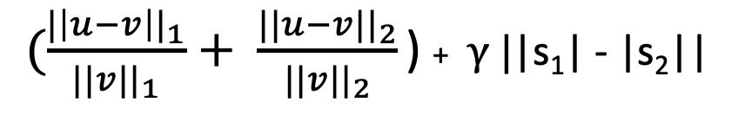
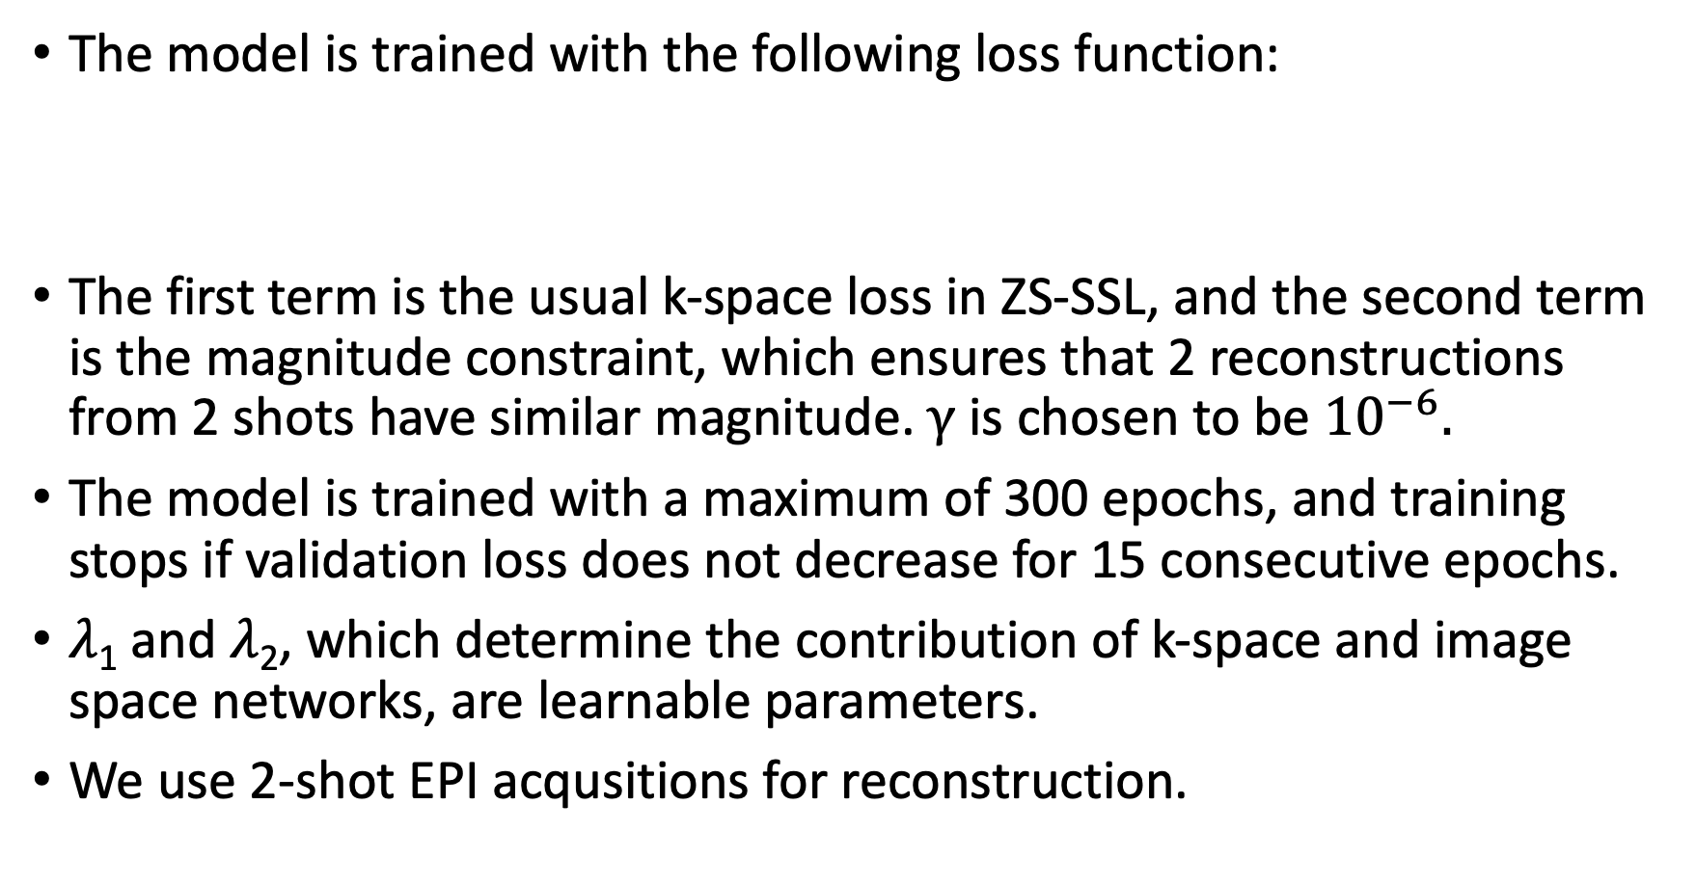
Training Details
The model is trained with the following loss function:
The first term is the usual k-space loss in ZS-SSL, and the second term is the magnitude constraint, which ensures that 2 reconstructions from 2 shots have similar magnitude.$γ$ is chosen to be ${10}^{−6}.$
The model is trained with a maximum of 300 epochs, and training stops if validation loss does not decrease for 15 consecutive epochs.
$λ$₁ and $λ$₂, which determine the contribution of k-space and image space networks, are learnable parameters.
We use 2-shot EPI acqusitions for reconstruction.
$(\frac{{|\left|u−v\right||}_{1}}{{||v||}_{1}}+ \frac{{||u−v||}_{2}}{{||v||}_{2}}$ ) +$γ \text{|}\text{|}\text{s}\text{1}\text{|}\text{ − |}\text{s}\text{2}\text{|}\text{|}$

Slide 6
5 Shot LORAKS
(Reference)
SENSE
Single Shot ZS-SSL
SHOT 1
%30.35
%16.53
SHOT 2
%24.6
%15.53
Acceleration Rate = 5

Slide 7
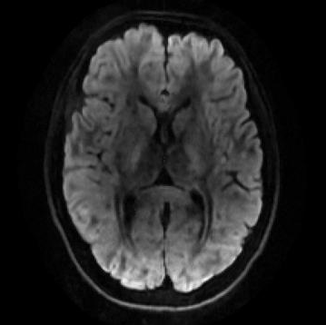
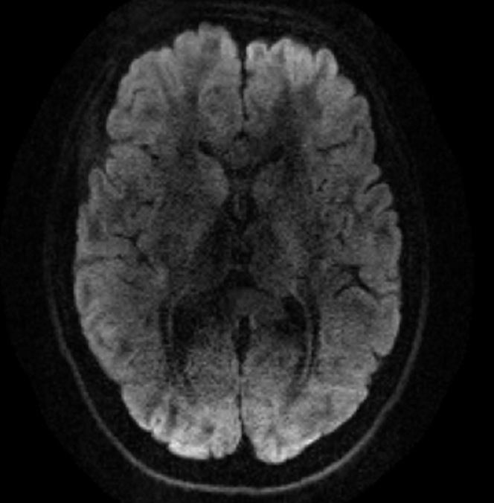
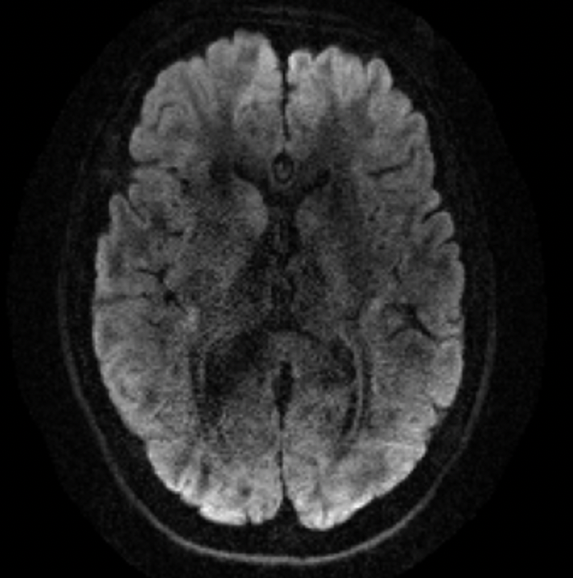
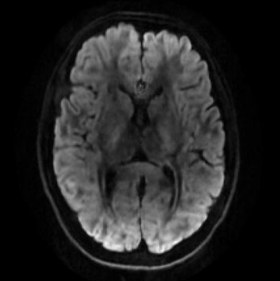
5 Shot LORAKS
(Reference)
2 Shot LORAKS
Proposed
SHOT 1
%15.12
%11.82
SHOT 2
%14.41
%13.42
Acceleration Rate = 5

Slide 8
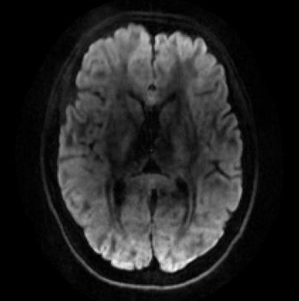
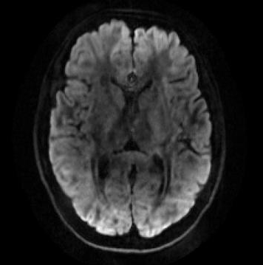
EFFECT of MAGNITUDE CONSTRAINT on MULTISHOT ZS-SSL
5-shot LORAKS
(Reference)
w/o Magnitude Constraint
w/ Magnitude Constraint
%16.53
%11.82
%14.61
%13.42

Slide 9
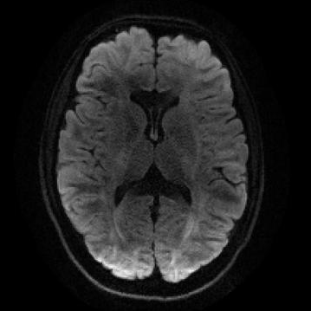
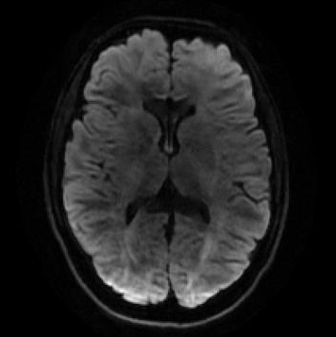
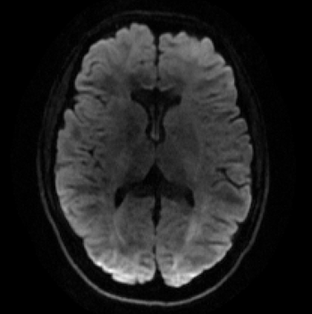
Joint Training Across All Directions
Instead of training a separate model for each diffusion direction, we may want to have a single model which can perform reconstruction across all directions.
Training jointly results in faster convergence of the model.
2 Shot ZS-SSL training time for one direction: 21.8 minutes
2 Shot ZS-SSL with joint training: 8.69 minutes / direction (∼2.5 times reduction in training time). (32 directions in total).
Training jointly or seperately results in similar reconstruction performance.
From top to bottom: 5 shot LORAKS, 2 Shot ZS-SSL, 2 Shot ZS-SSL with joint training.
%11.82
%11.39

Slide 10
Summary
Introduced a Zero-Shot Self Supervised Learning method for multishot diffusion MRI reconstruction.
Showed that including a magnitude constraint during training significantly improves reconstruction performance.
Showed that our proposed model can be trained for all directions at once, with an additional benefit of reduced training time.
Our method can yield better reconstruction than state-of-the-art LORAKS reconstruction.

